Slide 1

What Factors influence the Residential home prices across U.S the most using a data science model?
Created by: Mansi Varshney

Slide 2
Work Flow
Identifying data points
Data collection(Supply/demand)
Data cleaning(removing outliers, filled null values with mean)
Data Modelling
(with multiple linear regression model)

Slide 3

Key supply-demand factors that influence US home
prices
Demand
Supply
Building Permits(Permit Number)
Number of building permits allotted
Data Source: https://www.census.gov/construction/bps/
Mortgage Rates(%)
Data Source: https://fred.stlouisfed.org/graph/?g=zneW
Construction Spending (Million $)
The amount spent (in millions of USD) is a measure of the activity in the construction industry.
Data Source: https://www.census.gov/construction/c30/c30index.html
USA GDP(Billions$ )
Quarterly Real GDP (adjusted for inflation)
Data Source: https://fred.stlouisfed.org/series/GDPC1#0
Unemployment(%)
Data Source: https://fred.stlouisfed.org/series/UNRATE
Housing Starts(New Housing Project)
This is a measure of the number of units of new housing projects started in a given period.
Data Source: https://www.census.gov/construction/nrc/historical_data/index.html
Delinquency Rate on Mortgages
(Foreclosure on mortgage)
an indicator of the number of foreclosures in real estate.
Data Source: https://fred.stlouisfed.org/series/DRSFRMACBS#0
Homes Sold
House for sale is a basic measure of supply.
Data Source: https://www.census.gov/construction/nrs/historical_data/index.html

Slide 4
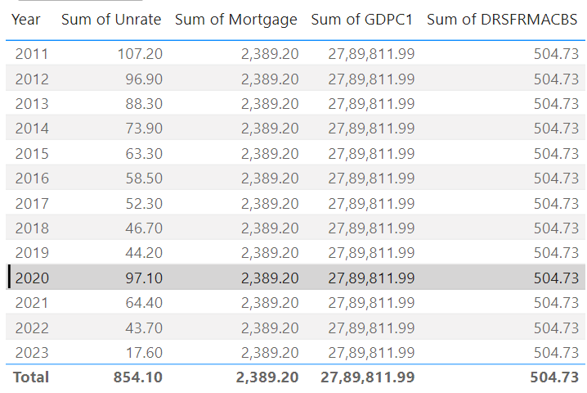
Demand Equation(Yearly data):
multivariable regression model Eqn
The S&P Case-Shiller Housing Price Index is taken as the y variable, or dependent variable, as an indicator of change in prices.
Taking all the other factors as independent variable .
Fig: Last 13 years Quarterly data

Slide 5
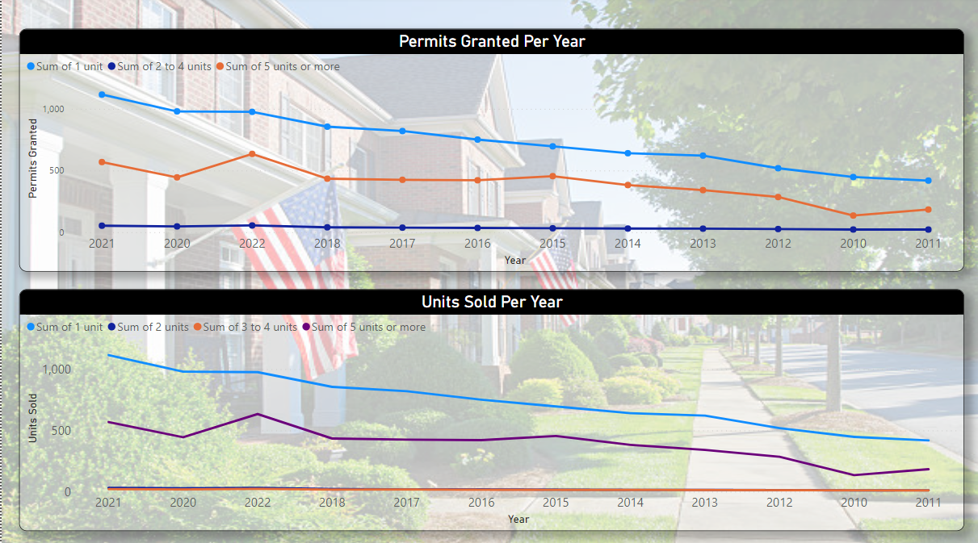
Supply Equation(Monthly data):
multivariable regression model Eqn
The S&P Case-Shiller Housing Price Index is taken as the y variable, or dependent variable, as an indicator of change in prices.
Taking all the other factors as independent variable .
Fig: Yearly data

Slide 6
Conclusion
As for housing demand eqn, for every 1% increase in Unemployment rate, there is a correlated 6.55% inc. in the HPI and for every 1% increase in Mortgage rate, there is a correlated 7.28% inc. in the HPI.Meanwhile, for every 1% increase in Foreclosure rate, there is a correlated -5.35 dec. in HPI & for every 100 billion increment in GDP there is correlated 2.47 unit increment in HPI
As for housing Supply eqn, for every 100 units increase in Building permits, there is a correlated 3.93 unit dec . in the HPI and for every 1000 million spending in Construction, there is a correlated 3.45 unit inc. in the HPI.
Meanwhile, for every 1000 increase in Housing starts, there is a correlated 2.29 unit dec. in HPI & for every 100 Home sold there is correlated 2.53 unit dec. in HPI.
The End

